Slide 1

Automated Deployment Pipeline with Jenkins and Docker
Supervised by: ENG. Ahmed Nasr

Slide 2
Team Members
Ahmed Sayed
David Nabil
Mohamed Ramadan
Shehab Mostafa
Yousef Mohamed

Slide 3
Content
Project Overview
Containerization
Environment Setup
Terraform For Building Infrastructure
Ansible For Configuration Of The Agents
Ansible For Application Deployment
Jenkins Pipelines

Slide 4
Project Overview(1/2)
This project demonstrates an end-to-end Continuous Integration/Continuous Deployment (CI/CD) pipeline using Jenkins, Docker, Ansible, and Terraform. The pipeline automates the process from code push to deployment, utilizing infrastructure as code (IAC) and containerization principles for consistent and automated deployments.

Slide 5
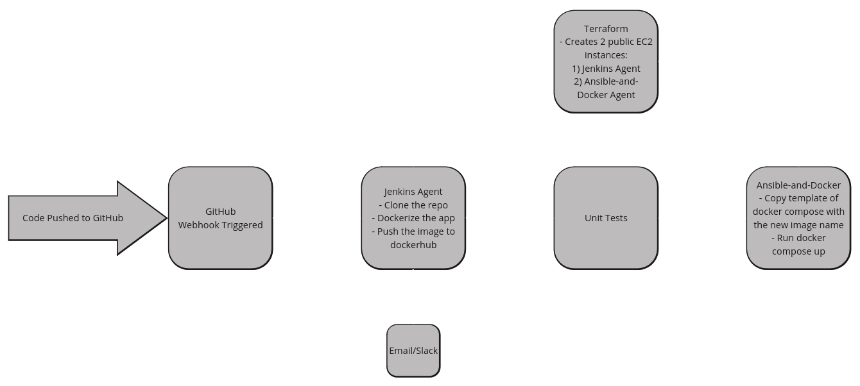
Project Overview (2/2)

Slide 6
Environment Setup

Slide 7
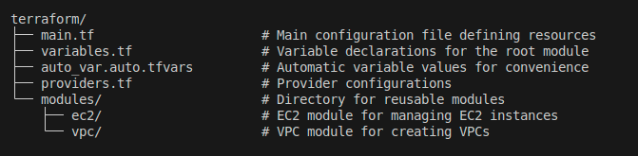
Terraform For Building Infrastructure (1/2)
Directory structure:

Slide 8
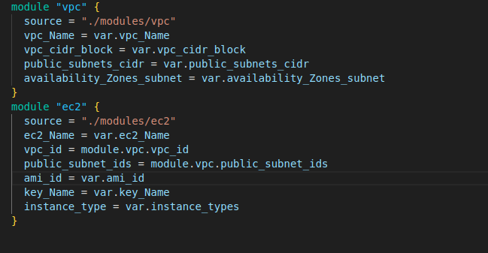
Terraform For Building Infrastructure (1/2)
main.tf

Slide 9
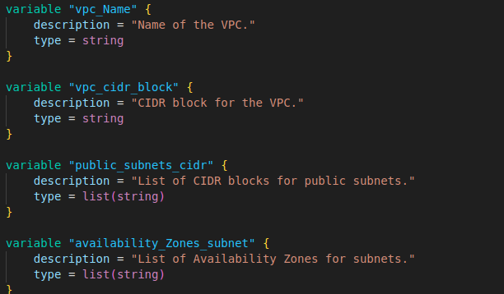
Terraform For Building Infrastructure (1/2)
variables.tf

Slide 10
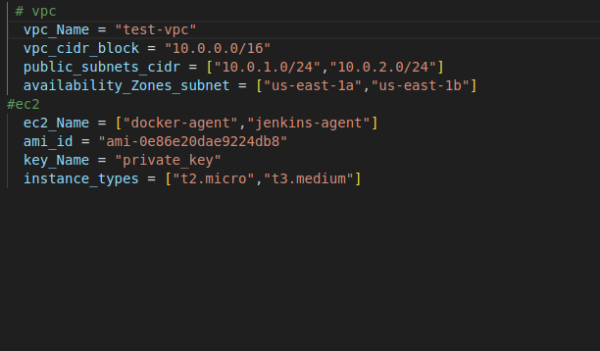
Terraform For Building Infrastructure (1/2)
auto_var.auto.tfvars.tf

Slide 11
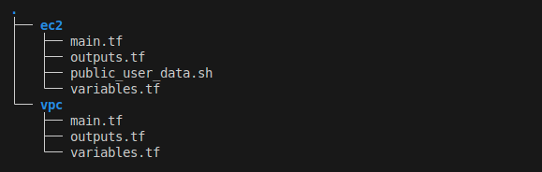
Terraform For Building Infrastructure (1/2)
Modules:
EC2 Module: This module is dedicated to managing ec2 instances, making it easy to provision and configure compute resources.
VPC Module: This module handles our Virtual Private Cloud setup including subnets, routing, and security groups.

Slide 12
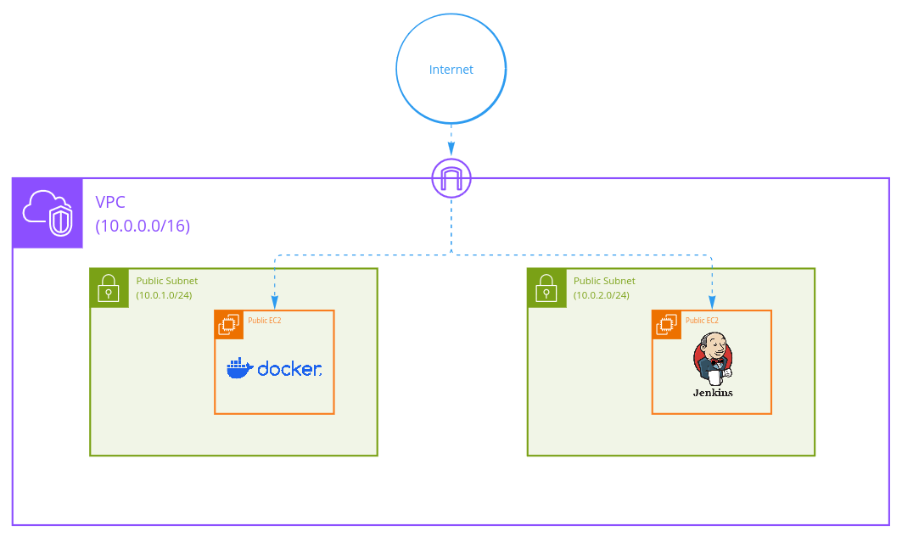
Infrastructure Diagram(1/2)

Slide 13
Ansible Playbook Overview (2/2)
Jenkins Installation:
Hosts: jenkins-agent
Role:
jenkins: This role handles the installation and configuration of Jenkins
Ansible and Docker Installation:
Hosts: docker-agent
Roles:
ansible: Installs Ansible for managing infrastructure.
docker: Installs Docker to support containerization.

Slide 14
Deployment tasks for the deploy role
Check for Existing Docker Compose File
This step ensures that any subsequent operations are conducted only if the application is already set up.
Stop and Remove Existing Containers
Render Docker Compose File
Deploy the Application

Slide 15
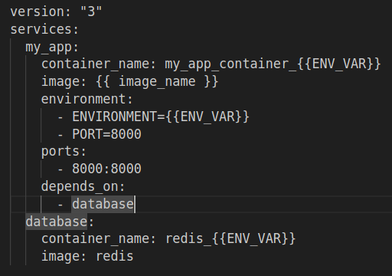
Docker Compose Template

Slide 16
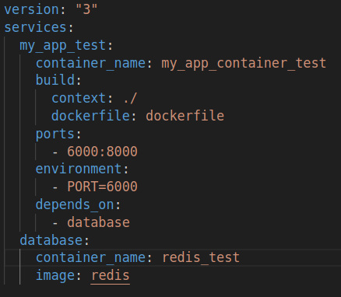
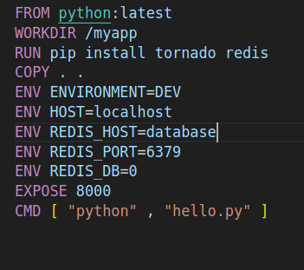
Containerization for development and Testing
Docker compose
Dockerfile

Slide 17
Build and test Pipeline (1/2)
Check Trigger:
The pipeline begins by checking if it was triggered by a GitHub webhook. This step helps determine the origin of the trigger and whether it is a result of a push or manual start.
Clone Repository:
The specified Git repository is cloned, allowing the pipeline to access the latest code in the main branch for building the Docker image.
Build Image:
A Docker image is built using the Dockerfile located in the counting_App directory. The image is tagged with a predefined version.

Slide 18
Build and test Pipeline (2/2)
4. Test Image:
The pipeline runs tests on the built Docker image:
It starts a temporary container to run the application tests using Docker Compose.
Unit tests are executed within the container to verify application functionality.
After testing, the container is brought down to clean up resources.
5. Push Image:
The built Docker image is pushed to Docker Hub.
6. Trigger Another Pipeline:
After successfully pushing the image, the pipeline triggers another Jenkins job , passing relevant parameters such as the Docker image name and build number for further processing.

Slide 19
Jenkins Pipeline for Application Deployment with Ansible
1. Clone Repository:
It pulls the latest code from the main branch, ensuring that the most up-to-date version of the application is available for deployment.
2. Deploy the Application:
In this stage, the pipeline executes an Ansible playbook to handle the deployment process:
The pipeline navigates to the app_deployment directory, where the Ansible playbook (deploy_playbook.yml) is located.
The playbook is executed with additional parameters passed as environment variables.

Slide 20
Post Actions
Email Notifications:
Upon success or failure, the pipeline sends email notifications detailing the job status. This feature ensures that relevant stakeholders are informed of the pipeline's outcome.

Slide 21
Some Groovy built in functions
1. git:
Clones the specified Git repository, fetching the latest code from the main branch.
2. docker.build():
Builds a Docker image from the specified context and tag.
3. docker.withRegistry():
Authenticates with the Docker registry before pushing images.
4. build:
Triggers another Jenkins job, passing parameters to it.
5. ansiblePlaybook():
Executes an Ansible playbook for application deployment, allowing the passing of variables.

Slide 22
Design decisions and the problems faced
Use t3.medium for the jenkins agent instead of t2.micro.
Create separated pipelines.
Choose Mailer plugin instead of Email extension plugin.
Solve the problem of the ports conflict.
Do Not use git clean -df (: .

Slide 23
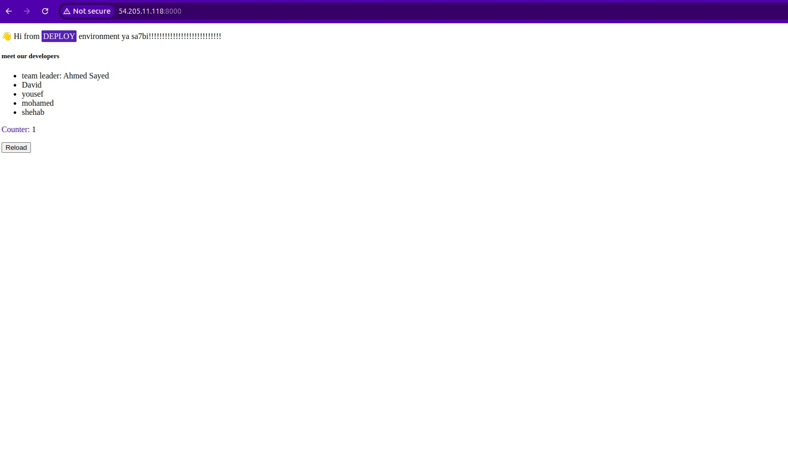
Screenshots
The website before update

Slide 24
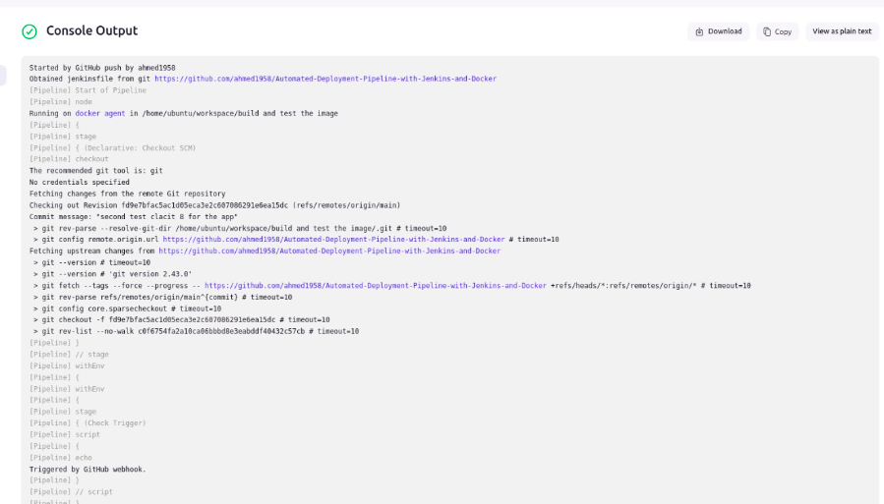
Screenshots

Slide 25
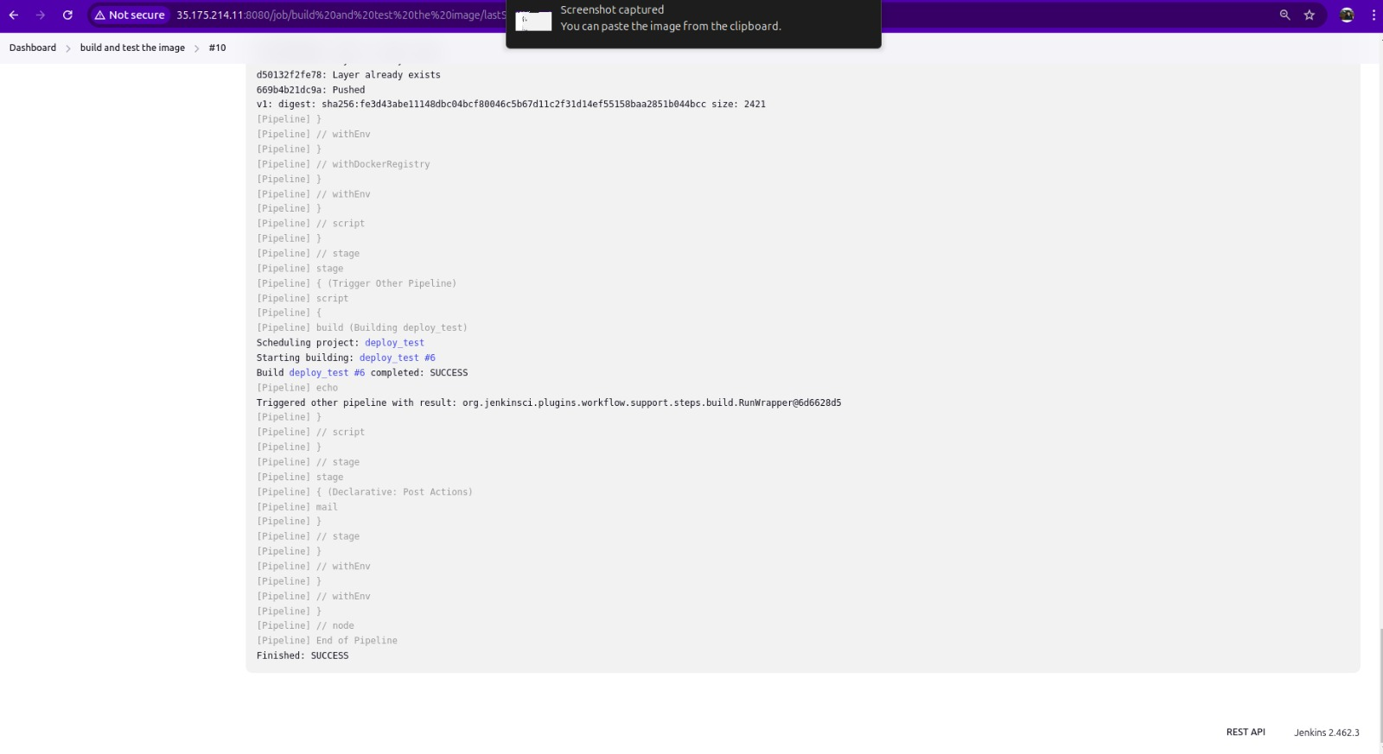
Screenshots
Success of the pipeline

Slide 26
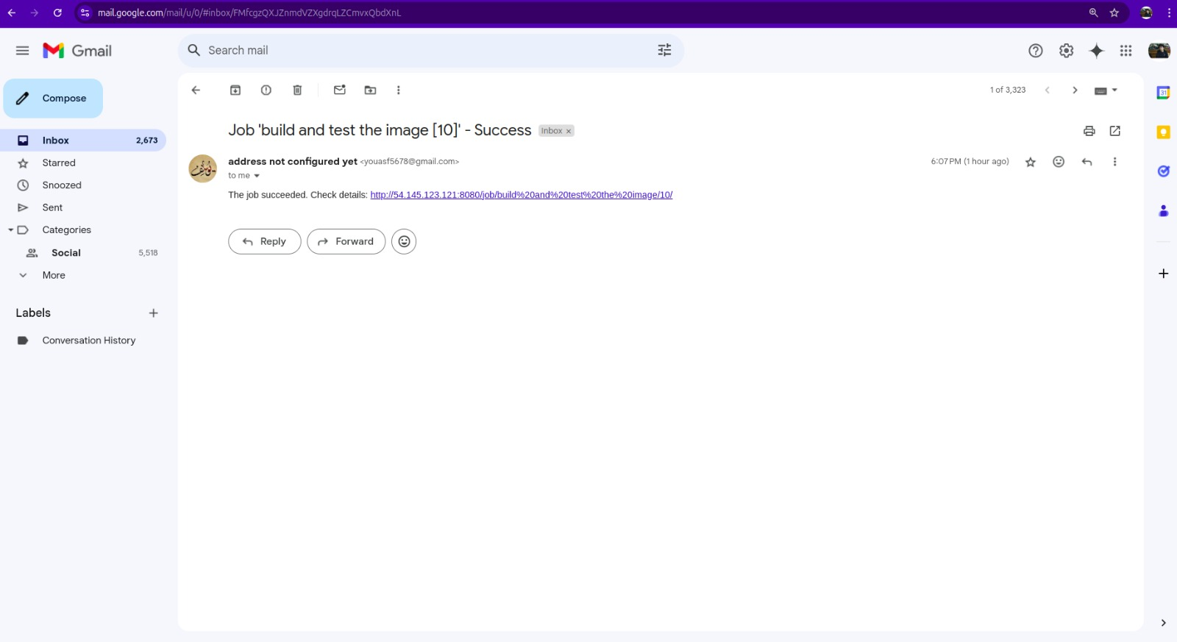
Screenshots
Mail

Slide 27
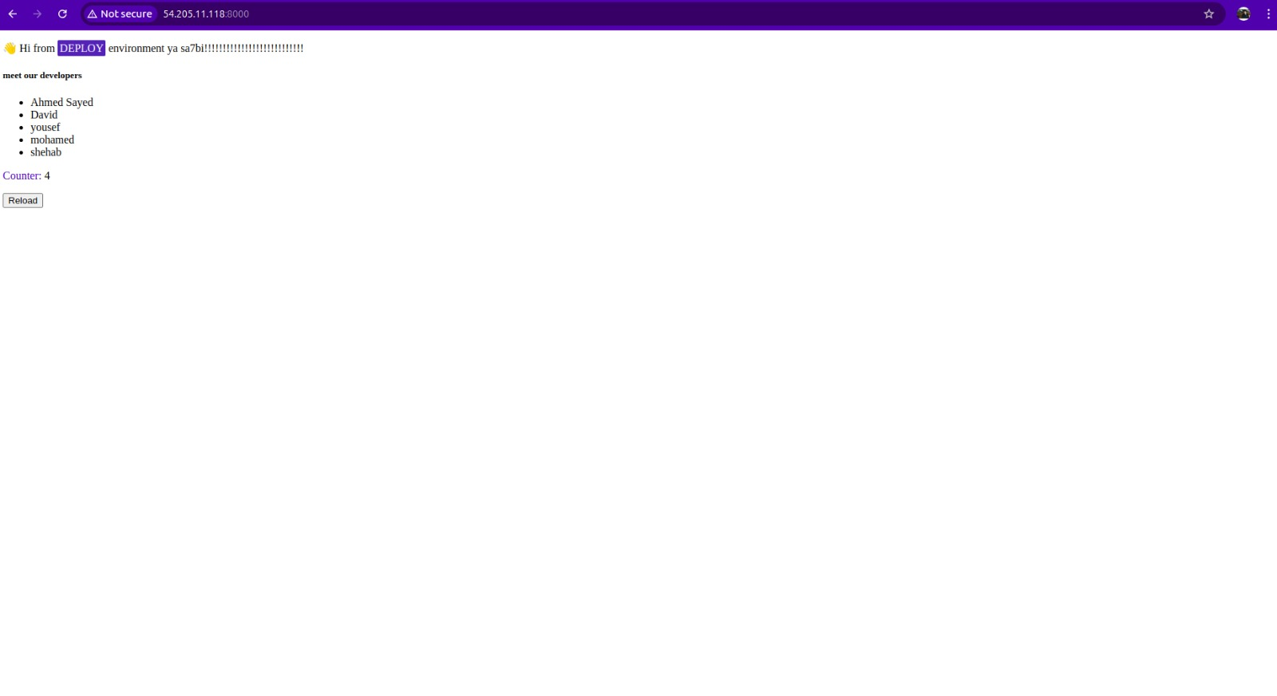
Screenshots
The website After update

Slide 28
Github link
https://github.com/ahmed1958/Automated-Deployment-Pipeline-with-Jenkins-and-Docker

Slide 29
Thank You !!

